Slide 1
Practice Lab:
This Practice Lab is dependent on Discussion Unit 7570, where most of the objects we create in this lab were introduced.
This Practice Lab has as a prerequisite Practice Lab 7445, where we loaded the DSE tables customer, orders, items from CSV.
This Practice Lab requires a working DSE system, with DSE Analytics enabled.
Because of the dependency on the "dse spark" utility, this Practice Lab requires a ssh(C) prompt on at least one node operating DSE Analytics.
Or, compile and run programs using an IDE.
DSE Analytics, Join, nulls, .isDefined, .get, map, filter, .saveToCassandra, and more
Notes:
The goal of this Practice Lab is to:
Load a DSE Core table from a 3 table join.
Produce jobs that report:
. Customers without orders
. Count of orders by state
. Orders where paid_date is null
. Count of orders by customer, sort by count descending

Slide 2

Working Goal:
From: Maury_Atwater
To: DSE_HOTSHOT
Subject: Need this now !!!
Big deal. You previously loaded 3 tables. ☹
Now join the SQL modeled customer and orders, and load the DSE modeled customer_orders.
I also need Jobs for:
. Customers without orders
. Count of orders by state
. Orders where paid_date is null
. Count of orders by customer, sort by
count descending
-MA
Maury Atwater, President of Atwater's
Notes:
The email above, lists our working goal.

Slide 3
CQL Assets for Reference:
DROP KEYSPACE IF EXISTS ks_7571;
CREATE KEYSPACE ks_7571 WITH REPLICATION =
{'class': 'SimpleStrategy',
'replication_factor': 1};
USE ks_7571;
CREATE TABLE customer
(
customer_num INT PRIMARY KEY,
fname TEXT,
lname TEXT,
company TEXT,
address1 TEXT,
address2 TEXT,
city TEXT,
state TEXT,
zipcode TEXT,
phone TEXT
);
Notes:
CQL assets for reference:

Slide 4
CQL Assets for Reference:
CREATE TABLE orders
(
order_num INT PRIMARY KEY,
order_date TEXT,
customer_num INT,
ship_instruct TEXT,
backlog TEXT,
po_num TEXT,
ship_date TEXT,
ship_weight FLOAT,
ship_charge FLOAT,
paid_date TEXT
);
CREATE TABLE customer_orders
(
order_num INT,
paid_date TEXT,
customer_num INT,
state TEXT,
PRIMARY KEY((order_num), customer_num)
);
Notes:
CQL assets for reference:

Slide 5

Challenge 1: Customers with no Orders
Read from customer and orders
Use a leftOuterJoin
Then filter using .isDefined
Just read; customer_num (both tables), state, order_num, paid_date
Why ? We can re-use these RDDs later
There are 11 rows by count
Source:https://www.pinterest.com/pin/5629568257464509/
Notes:
Create a DSE Analytics (Apache Spark) job that reports customer rows with no associated order row.
To get the correct results, be certain you are starting with data sets equal to the original CSV files.
Questions:
Why do we need an outer join ?

Slide 6

Challenge 2: Load customer_orders
By far the hardest of the challenges
It's always the little things; nulls, nits in the APIs, yadda
Keep it simple; we're only keeping 4 columns to reduce burden
Best effort, then check answer at end of unit
You need customer_orders for the remaining challenges
All other challenges are do-able
Notes:
Relative to this challenge:
You need to produce an RDD from customer, and one from orders.
We're only keeping 4 columns to reduce burden on programming.
There's a null, and it's annoying, needing about 4 steps to overcome.
The join wants one kind of RDD contents, and the write to DSE wants another.
After (n) minutes, cheat; answer at end of unit.
You need customer_order populated to complete remaining challenges.

Slide 7
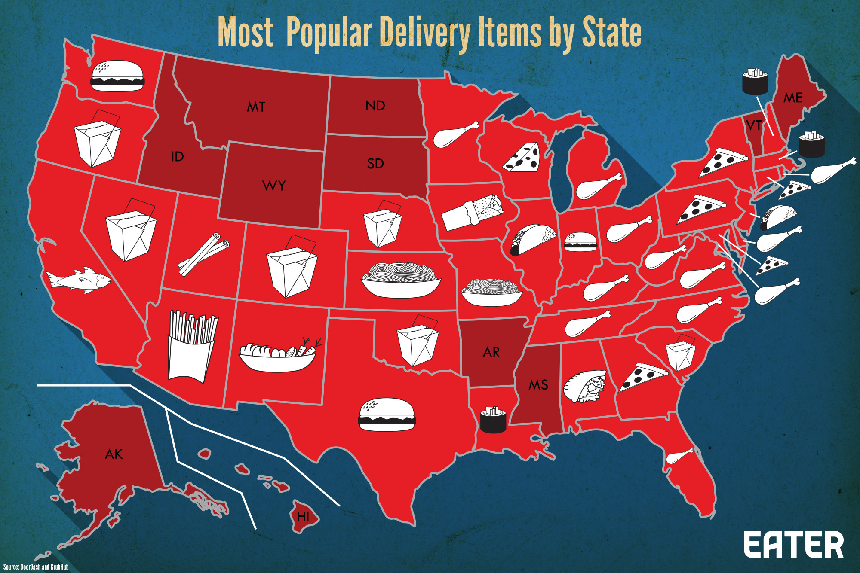
Challenge 3: Count of Orders by State
Need customer_orders
4 lines; map, and reduceByKey()
Output just state and count
Source: https://www.eater.com/2016/9/26/13051528/most-ordered-food-delivery-america
Notes:
Produce a count of orders by state-

Slide 8

Challenge 4: Rows where paid_date is (null)
Mismatch between: DSE, Spark, Scala
Advice in Scala is to remove nulls immediately; use a constant
Spark has methods
DSE has other ideas of its own
Our solution used a constant, ("N/A")
Notes:
Relative to this challenge:
Our solution put a non-null constant in paid_date, ("N/A")
In the real world, that's cheating; need a clear and real standard.
3 Lines done properly

Slide 9

Challenge 5: High Value Customers
Count of orders by customer, sort by count descending
Output customer number and count
Bonus: also output state
5 lines
Notes:
Produce a high value customers job; customer number and order count, count descending

Slide 10

Practice Lab:
Lessons learned
Notes:
Discuss what worked well, poorly, from the Practice Lab.

Slide 11
End of Unit:
Notes:
End of Practice Lab-

Slide 12
Additional Detail:
Notes:
The remaining content may be read “extra credit”, as time allows.

Slide 13
Answer to just challenge 2 is on the Notes page-
Notes:
// Spark
case class My_Customer (
customer_num:Int,
state:String
)
case class My_Order (
order_num:Int,
paid_date:Option[String],
customer_num:Int
)
case class My_CustomerOrder (
order_num:Int,
paid_date:String,
customer_num:Int,
state:String
)
// load customer_orders (orders with customers)
val c_rows = sc.cassandraTable("ks_7571", "customer").
select("customer_num", "state").
as((customer_num:Int, state:String) =>
(customer_num, (state)))
val o_rows = sc.cassandraTable("ks_7571", "orders").
select("customer_num", "order_num", "paid_date").
as((customer_num:Int, order_num:Int,
paid_date:String) => (customer_num,
(order_num, paid_date)))
val j_rows = o_rows.join(c_rows)
j_rows.collect().foreach(println)
(119,((1016,null),NJ))
(112,((1006,null),CA))
(126,((1022,09/02/1998),CO))
(120,((1017,null),AZ))
(127,((1023,08/22/1998),NY))
(106,((1004,null),CA))
(106,((1014,07/10/1998),CA))
(121,((1018,08/06/1998),DE))
(122,((1019,08/06/1998),NJ))
(115,((1010,08/22/1998),CA))
(101,((1002,06/03/1998),CA))
(116,((1005,06/21/1998),CA))
(123,((1020,09/20/1998),FL))
(117,((1007,null),CA))
(117,((1012,null),CA))
(110,((1015,08/31/1998),CA))
(110,((1008,07/21/1998),CA))
(124,((1021,08/22/1998),OK))
(104,((1013,07/31/1998),CA))
(104,((1011,08/29/1998),CA))
(104,((1001,07/22/1998),CA))
(104,((1003,06/14/1998),CA))
(111,((1009,08/21/1998),CA))
val j_rows = o_rows.leftOuterJoin(c_rows).
filter{case (pk, (row_o, row_c)) => row_c.isDefined}
j_rows.collect().foreach(println)
(119,((1016,null),Some(NJ)))
(112,((1006,null),Some(CA)))
(126,((1022,09/02/1998),Some(CO)))
(120,((1017,null),Some(AZ)))
(127,((1023,08/22/1998),Some(NY)))
(106,((1004,null),Some(CA)))
(106,((1014,07/10/1998),Some(CA)))
(121,((1018,08/06/1998),Some(DE)))
(122,((1019,08/06/1998),Some(NJ)))
(115,((1010,08/22/1998),Some(CA)))
(101,((1002,06/03/1998),Some(CA)))
(116,((1005,06/21/1998),Some(CA)))
(123,((1020,09/20/1998),Some(FL)))
(117,((1007,null),Some(CA)))
(117,((1012,null),Some(CA)))
(110,((1015,08/31/1998),Some(CA)))
(110,((1008,07/21/1998),Some(CA)))
(124,((1021,08/22/1998),Some(OK)))
(104,((1013,07/31/1998),Some(CA)))
(104,((1011,08/29/1998),Some(CA)))
(104,((1001,07/22/1998),Some(CA)))
(104,((1003,06/14/1998),Some(CA)))
(111,((1009,08/21/1998),Some(CA)))
// case class My_CustomerOrder (
// order_num:Int,
// paid_date:String,
// customer_num:Int,
// state:String
// )
// (111,((1009,08/21/1998),Some(CA)))
// Flattening out the tuples
//
val j_rows = o_rows.leftOuterJoin(c_rows).
filter{case (pk, (row_o, row_c)) => row_c.isDefined}.
map{r => ( r._1, r._2._1._2, r._2._1._1, r._2._2 )}
j_rows.collect().foreach(println)
(119,null,1016,Some(NJ))
(112,null,1006,Some(CA))
(126,09/02/1998,1022,Some(CO))
(120,null,1017,Some(AZ))
(127,08/22/1998,1023,Some(NY))
(106,null,1004,Some(CA))
(106,07/10/1998,1014,Some(CA))
(121,08/06/1998,1018,Some(DE))
(122,08/06/1998,1019,Some(NJ))
(115,08/22/1998,1010,Some(CA))
(101,06/03/1998,1002,Some(CA))
(116,06/21/1998,1005,Some(CA))
(123,09/20/1998,1020,Some(FL))
(117,null,1007,Some(CA))
(117,null,1012,Some(CA))
(110,08/31/1998,1015,Some(CA))
(110,07/21/1998,1008,Some(CA))
(124,08/22/1998,1021,Some(OK))
(104,07/31/1998,1013,Some(CA))
(104,08/29/1998,1011,Some(CA))
(104,07/22/1998,1001,Some(CA))
(104,06/14/1998,1003,Some(CA))
(111,08/21/1998,1009,Some(CA))
// Need to repair the null value
//
// And remove the Some() .get does that for us.
val j_rows = o_rows.leftOuterJoin(c_rows).
filter{case (pk, (row_o, row_c)) => row_c.isDefined}.
map{r => ( r._1, Option(r._2._1._2), r._2._1._1, r._2._2 )}.
map{r => ( r._1, r._2.getOrElse("N/A"), r._3, r._4.get )}
j_rows.collect().foreach(println)
(119,N/A,1016,NJ)
(112,N/A,1006,CA)
(126,09/02/1998,1022,CO)
(120,N/A,1017,AZ)
(127,08/22/1998,1023,NY)
(106,N/A,1004,CA)
(106,07/10/1998,1014,CA)
(121,08/06/1998,1018,DE)
(122,08/06/1998,1019,NJ)
(115,08/22/1998,1010,CA)
(101,06/03/1998,1002,CA)
(116,06/21/1998,1005,CA)
(123,09/20/1998,1020,FL)
(117,N/A,1007,CA)
(117,N/A,1012,CA)
(110,08/31/1998,1015,CA)
(110,07/21/1998,1008,CA)
(124,08/22/1998,1021,OK)
(104,07/31/1998,1013,CA)
(104,08/29/1998,1011,CA)
(104,07/22/1998,1001,CA)
(104,06/14/1998,1003,CA)
(111,08/21/1998,1009,CA)
j_rows.saveToCassandra("ks_7571", "customer_orders",
SomeColumns("customer_num", "paid_date",
"order_num", "state"))

